Slide 1
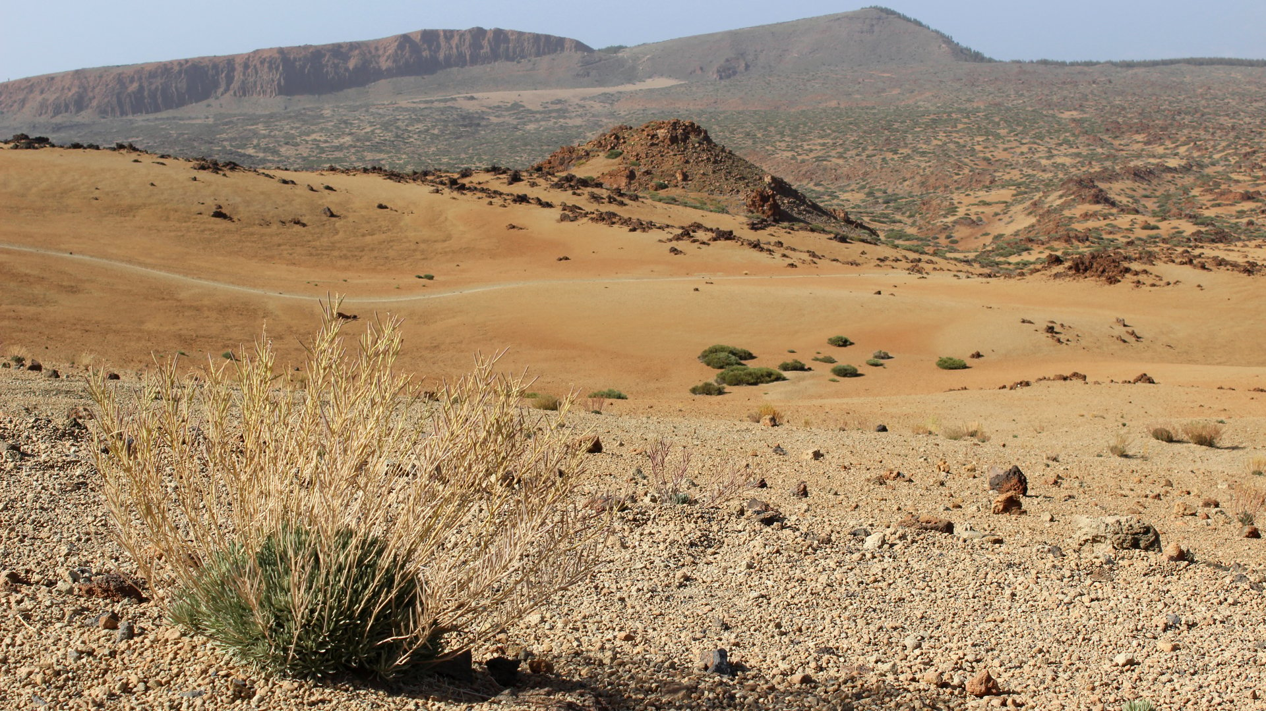
Philippians 4:10 - 13
The Secret of Being Content
Dan Bridges Amman International Church, Jordan (AmmanChurch.org) Uploaded by Dr. Rick Griffith • Jordan Evangelical Theological Seminary Files in many languages for free download at BibleStudyDownloads.org

Slide 2
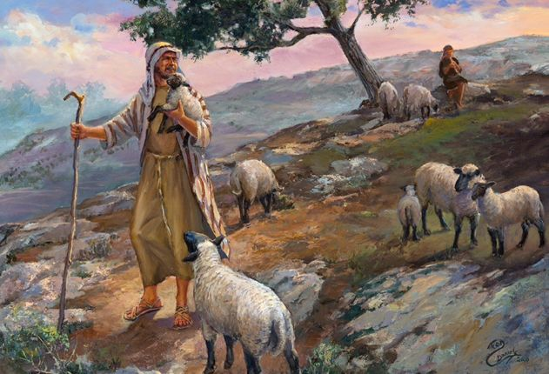
What does it Mean to “Not Want”?
The Lord is my shepherd; I shall not want.
He makes me lie down in green pastures.
He leads me beside still waters.
He restores my soul.
He leads me in paths of righteousness
for his name's sake.
Psalm 23:1-3

Slide 3
To Not Want Means to “Not Lack”
For the Lord your God has blessed you in all the work of your hands. He knows your going through this great wilderness. These forty years the Lord your God has been with you. You have lacked nothing.
Deuteronomy 2:7

Slide 4
How many people do you know who would say they lack nothing in life?

Slide 5
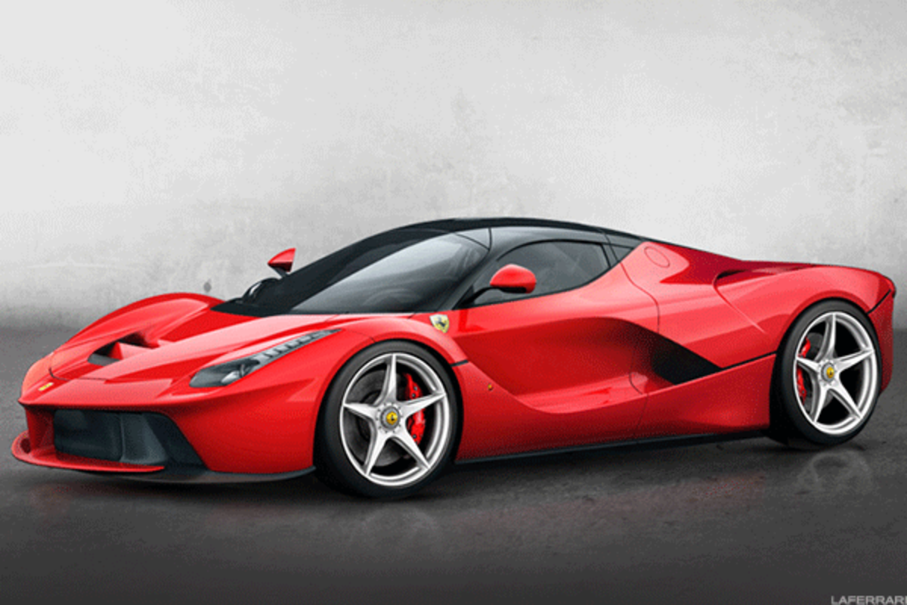
Everything around us tells us we don’t have everything we need to be happy!

Slide 6
Main Point
God intends and empowers his people to live lives of contentment!

Slide 7
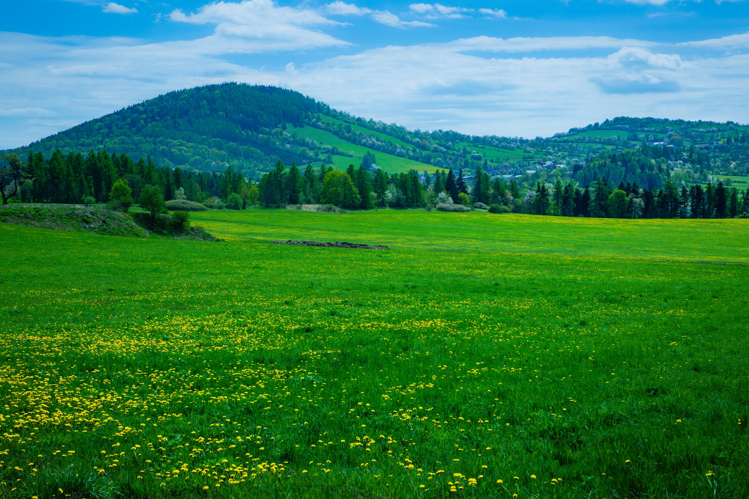
¹⁰ I rejoiced in the Lord greatly that now at length you have revived your concern for me. You were indeed concerned for me, but you had no opportunity. ¹¹ Not that I am speaking of being in need, for I have learned in whatever situation I am to be content.
Philippians 4:10-11

Slide 8
¹² I know how to be brought low, and I know how to abound. In any and every circumstance, I have learned the secret of facing plenty and hunger, abundance and need. ¹³ I can do all things through him who strengthens me.
Philippians 4:12-13

Slide 9
Learning the Secret of Being Content
Overview of the Passage
Defining Contentment
Understanding the Secret

Slide 10
Overview of the Passage
¹⁰ I rejoiced in the Lord greatly that now at length you have revived your concern for me. You were indeed concerned for me, but you had no opportunity.
Vss 10-19 are Paul’s “thank you”
It had been a long time since they had shown their concern for Paul
Paul had “rejoiced greatly” at their gift

Slide 11
Overview of the Passage
¹¹ Not that I am speaking of being in need, for I have learned in whatever situation I am to be content.
Clarification: Paul’s joy had not been at his needs being met by their gift.
Paul had not seen himself as being “in need” because he had learned to be content.

Slide 12
Overview of the Passage
¹² I know how to be brought low, and I know how to abound. In any and every circumstance, I have learned the secret of facing plenty and hunger, abundance and need.
Paul had “learned the secret” of being content regardless of (and through) his circumstances!

Slide 13
Overview of the Passage
¹³ I can do all things through him who strengthens me.
It was Christ who enabled Paul to be content

Slide 14
Learning the Secret of Being Content
Overview of the Passage
Defining Contentment
Understanding the Secret

Slide 15
What is Contentment?
What are we often discontent about?
Financial situation
Not being married
Our kids
Our jobs
Foreign culture
Our looks
Our teachers
Traffic
Possessions
Spouse
Sexual fulfillment
Our ministries
Our friends
Our abilities
Our students
Being busy

Slide 16
What is Contentment?
Contentment is NOT:
Denying hurt and disappointment
Pretending everything is as you want it to be
Settling for things in our lives that are not as they should be

Slide 17
What is Contentment?
We usually view Contentment to mean:
Being satisfied
Having our expectations met
Pleased with what we have experienced or received

Slide 18
What is Contentment?
¹⁰ For the sake of Christ, then, I am content with weaknesses, insults, hardships, persecutions, and calamities. For when I am weak, then I am strong.
2 Corinthians 12:10
Satisfied?
Expectations met?
Pleased with experience?

Slide 19
What is Contentment?
¹¹ Not that I am speaking of being in need, for I have learned in whatever situation I am to be content.
Gk: autárkēs
From autos (himself) and arkéō (to suffice)
Meaning: self-sufficient!
(independent of external circumstances)

Slide 20
What is Contentment?
¹¹ Not that I am speaking of being in need, for I have learned in whatever situation I am to be content… ¹³ I can do all things through him who strengthens me.
Gk: autárkēs
From autos (himself) and arkéō (to suffice)
Meaning: self-sufficient!
(independent of external circumstances)
Christ-sufficient!

Slide 21
What is Contentment?
arkéo
⁹ But he said to me, “My grace is sufficient for you, for my power is made perfect in weakness.” Therefore I will boast all the more gladly of my weaknesses, so that the power of Christ may rest upon me. ¹⁰ For the sake of Christ, then, I am content with weaknesses, insults, hardships, persecutions, and calamities. For when I am weak, then I am strong.
2 Corinthians 12:9-10
Sufficient – Able to handle…
arkéo

Slide 22
What is Contentment?
autárkēs
⁶ But godliness with contentment is great gain, ⁷ for we brought nothing into the world, and we cannot take anything out of the world. ⁸ But if we have food and clothing, with these we will be content.
1 Timothy 6:6-8
Self-Sufficient – Well-being is Independent of money
Sufficient – Satisfied
(because well-being independent of money)
arkéo

Slide 23
What is Contentment?
Definition:
Being confident that you have all that you need for whatever you are facing
Therefore being at peace (satisfied) with your current situation

Slide 24
What is Contentment?
Contentment is saying:
“I don’t like _____ that is going on in my life, but I know that with Christ’s strength I can cope with it and be okay in my heart!”
We may say “I don’t like it”,
but we don’t say, “I can’t handle it”!

Slide 25
Learning the Secret of Being Content
Overview of the Passage
Defining Contentment
Understanding the Secret

Slide 26
Understanding the Secret – How do we Get It?
¹¹ Not that I am speaking of being in need, for I have learned in whatever situation I am to be content.
It was something Paul needed to learn
This learning is manthánō “To know fully; To learn by experience”

Slide 27
Understanding the Secret – How do we Get It?
¹² I know how to be brought low, and I know how to abound. In any and every circumstance, I have learned the secret of facing plenty and hunger, abundance and need.
Paul’s experiences through which he learned contentment: 3 Pairs

Slide 28
Experiences God Used to Teach Paul
Brought low – humbled; poor and needy
Abound – to be in excess; to overflow
Plenty – to be filled or satisfied (with food)
Hunger – To be famished; without food
Abundance – to be in excess; to overflow
Need – To be destitute

Slide 29
Understanding the Secret – How do we Get It?
¹² I know how to be brought low, and I know how to abound. In any and every circumstance, I have learned the secret of facing plenty and hunger, abundance and need.
Just as with Paul, or the Israelites in the wilderness, God is actively putting you through experiences designed to teach you trust / contentment!

Slide 30
Understanding the Secret – How do we Get It?
¹² I know how to be brought low, and I know how to abound. In any and every circumstance, I have learned the secret of facing plenty and hunger, abundance and need.
There are no short cuts! Life is the classroom. It is through wrestling through life’s circumstances that we learn contentment!

Slide 31
But What’s the Secret?
¹² I know how to be brought low, and I know how to abound. In any and every circumstance, I have learned the secret of facing plenty and hunger, abundance and need.
Gk: muéo – to initiate into the mysteries
(Used of pagan religious initiation rites)

Slide 32
But What’s the Secret?
¹² I know how to be brought low, and I know how to abound. In any and every circumstance, I have learned the secret of facing plenty and hunger, abundance and need. ¹³ I can do all things through him who strengthens me.

Slide 33
Why Don’t We All Learn This?
The resource of Christ in us is only available to believers in Jesus.
It’s not enough to go through difficult circumstances. We must learn from them.

Slide 34
Learning Contentment
What are we often discontent about?
Financial situation
Not being married
Our kids
Our jobs
Foreign culture
Our looks
Our teachers
Traffic
Possessions
Spouse
Sexual fulfillment
Our ministries
Our friends
Our abilities
Our students
Being busy
Our normal human responses to discontentment in these areas:
Discouragement, Anger, Depression
Sinful attempts to get what we want

Slide 35
Learning Contentment
What are we often discontent about?
Financial situation
Not being married
Our kids
Our jobs
Foreign culture
Our looks
Our teachers
Traffic
Possessions
Spouse
Sexual fulfillment
Our ministries
Our friends
Our abilities
Our students
Being busy
Basic premise of biblical contentment:
True contentment has nothing to do with our circumstances. It has everything to do with how we think about our circumstances!

Slide 36
Learning Contentment
⁹ But he said to me, “My grace is sufficient for you, for my power is made perfect in weakness.” Therefore I will boast all the more gladly of my weaknesses, so that the power of Christ may rest upon me. ¹⁰ For the sake of Christ, then, I am content with weaknesses, insults, hardships, persecutions, and calamities. For when I am weak, then I am strong.
2 Corinthians 12:9-10
What can we pray for?

Slide 37
Learning Contentment
⁸ Finally, brothers, whatever is true, whatever is honorable, whatever is just, whatever is pure, whatever is lovely, whatever is commendable, if there is any excellence, if there is anything worthy of praise, think about these things.
Philippians 4:8
What can we choose to think about?

Slide 38
Learning Contentment
⁴ For the weapons of our warfare are not of the flesh but have divine power to destroy strongholds. ⁵ We destroy arguments and every lofty opinion raised against the knowledge of God, and take every thought captive to obey Christ. 2 Corinthians 10:4-5

Slide 39
Learning Contentment
What are we often discontent about?
Financial situation
Not being married
Our kids
Our jobs
Foreign culture
Our looks
Our teachers
Traffic
Possessions
Spouse
Sexual fulfillment
Our ministries
Our friends
Our abilities
Our students
Being busy
Is it okay to try to change our circumstances?
Yes!
Am I doing this selfishly – for contentment?
Am I doing this in God’s will and plan?

Slide 40
Learning Contentment - Summary
Identify the area of discontentment (from complaining, anxiety, unfulfilled desires, reasons for depression, etc.)
Start with honest prayer (“I can do all things through Christ who gives me strength.”)
With Christ, through prayer, journaling, processing with friends, fight the mind battle!
Address sinful actions in this area
Stay in this process as long as necessary!

Slide 41
Why Go to All this Work?
¹⁰ And whatever my eyes desired I did not keep from them. I kept my heart from no pleasure, for my heart found pleasure in all my toil, and this was my reward for all my toil. ¹¹ Then I considered all that my hands had done and the toil I had expended in doing it, and behold, all was vanity and a striving after wind, and there was nothing to be gained under the sun.
Ecclesiastes 2:10-11
There is no contentment to be found in pursuing contentment apart from God!

Slide 42
Main Point
God intends and empowers his people to live lives of contentment!

Slide 43
Learning Contentment
What are we often discontent about?
Financial situation
Not being married
Our kids
Our jobs
Foreign culture
Our looks
Our teachers
Traffic
Possessions
Spouse
Sexual fulfillment
Our ministries
Our friends
Our abilities
Our students
Being busy
Where would God have you start?

Slide 45
NT Preaching link at BibleStudyDownloads.org
Get this presentation for free!
Notes:
NT Preaching (np)

